Slide 1
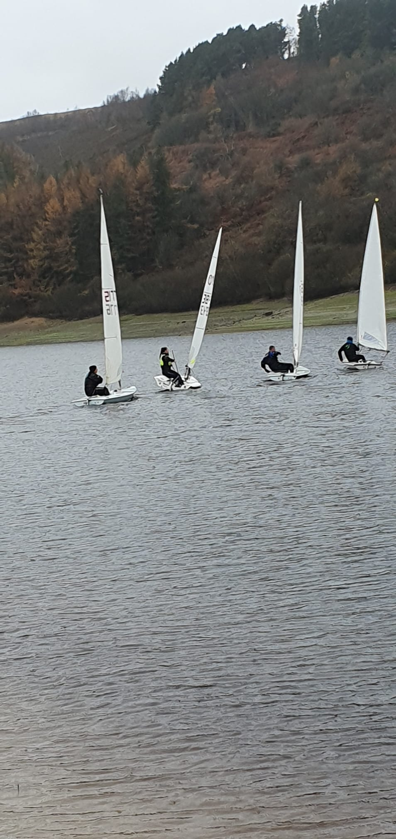
Scammonden Water
Sailing Club
Yearbook 2025
www.scammondensailing.com

Slide 2
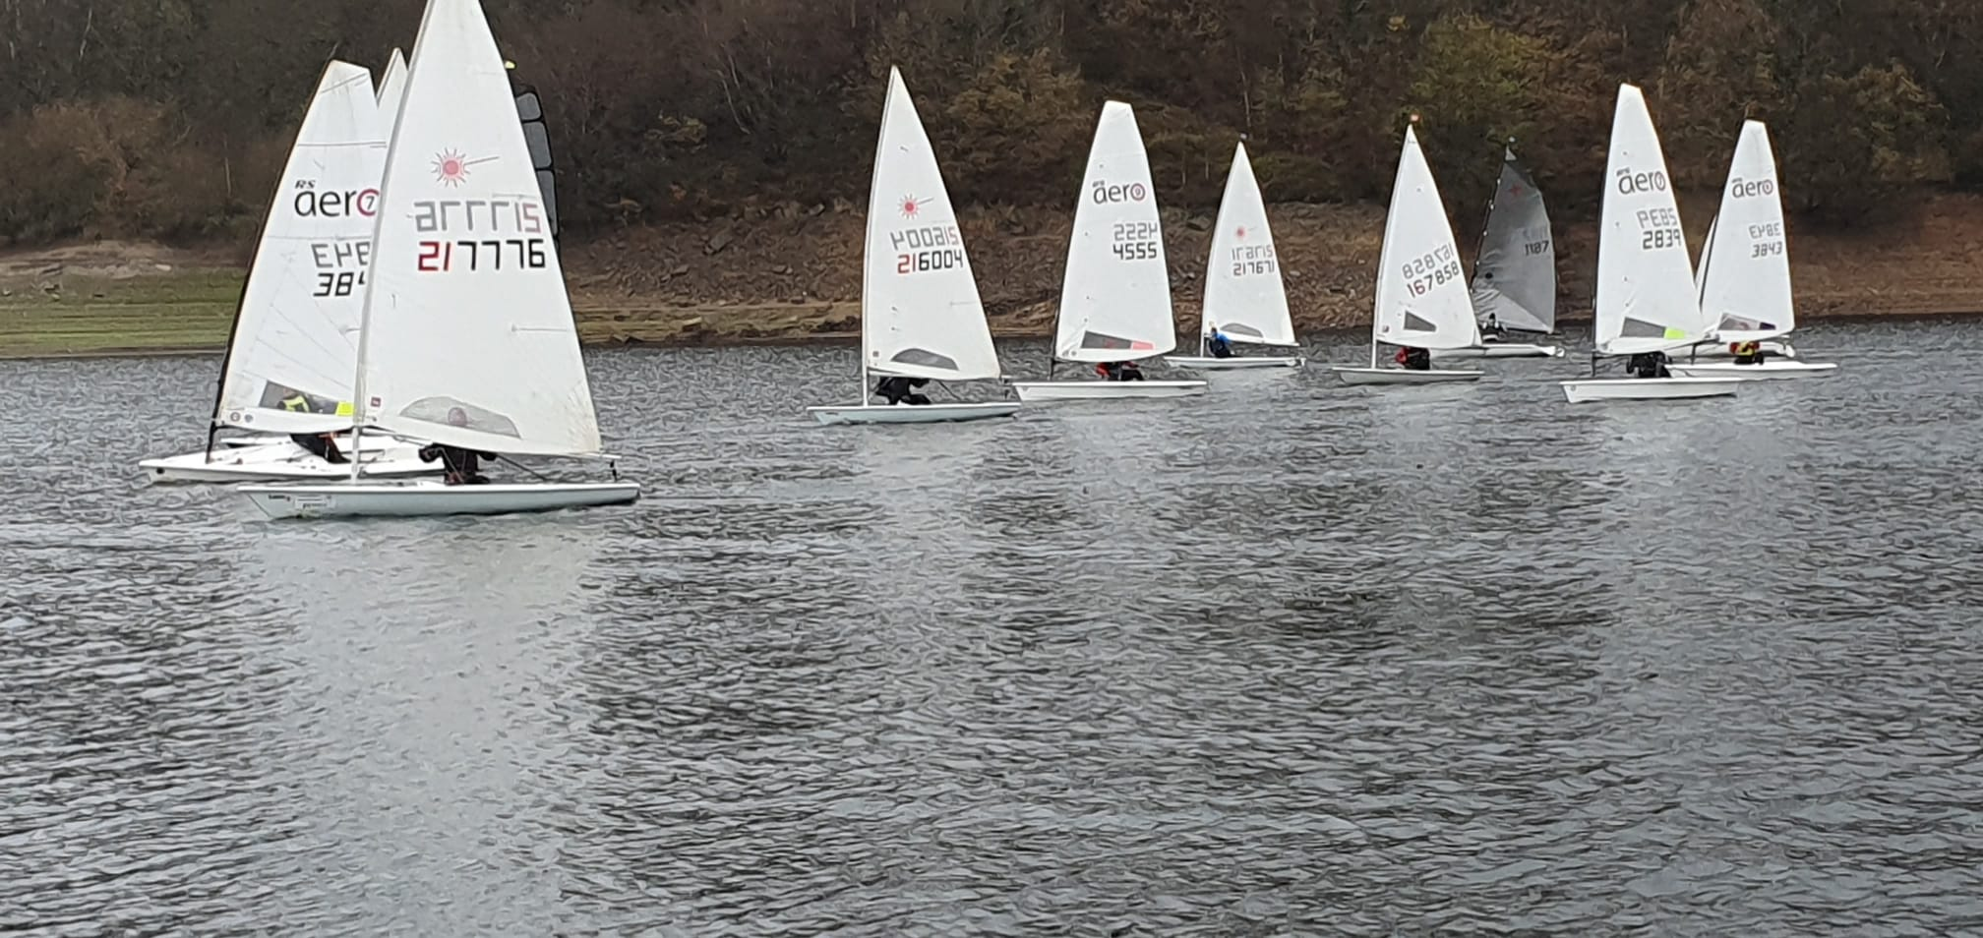
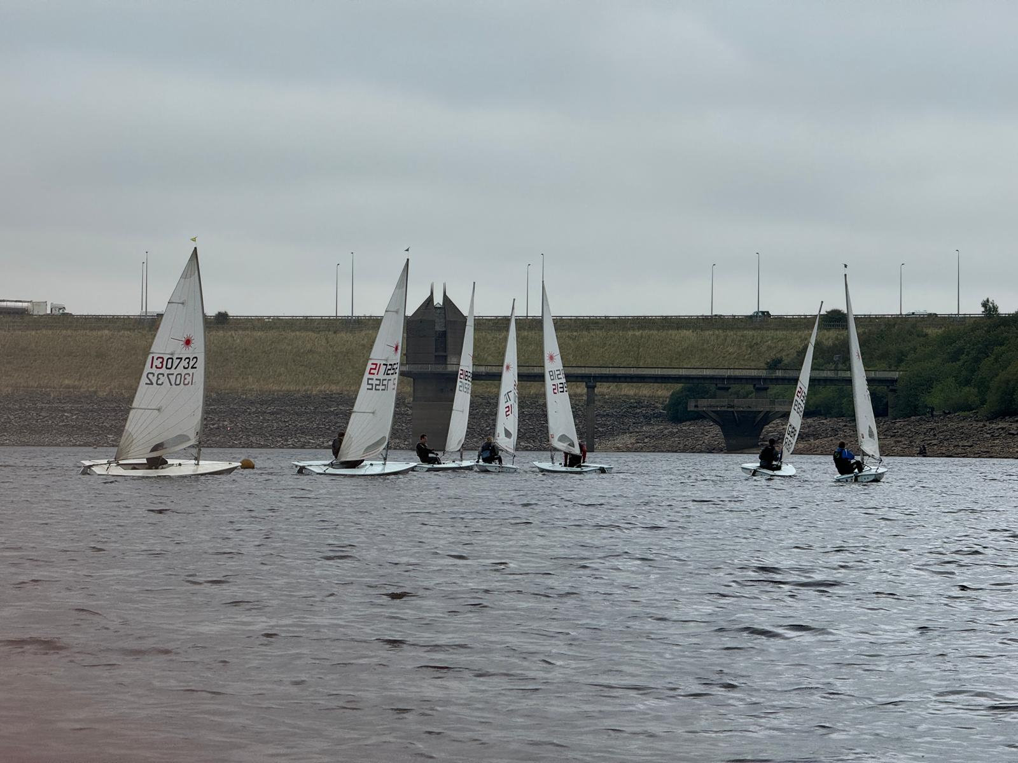
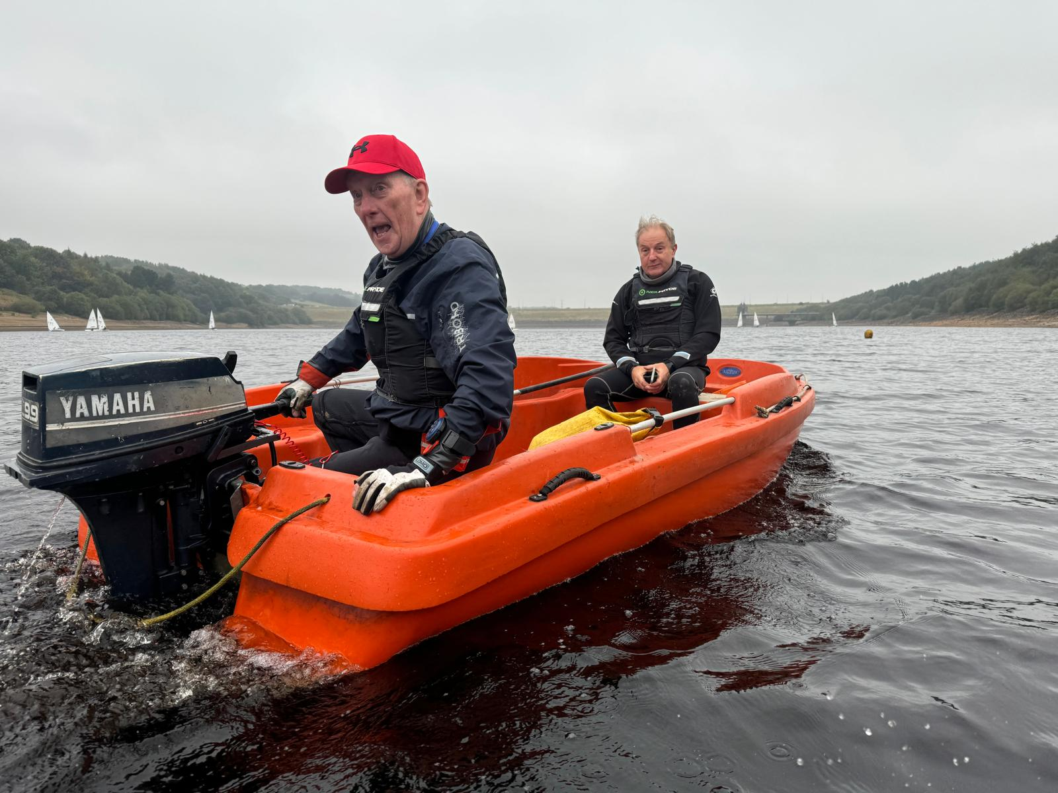
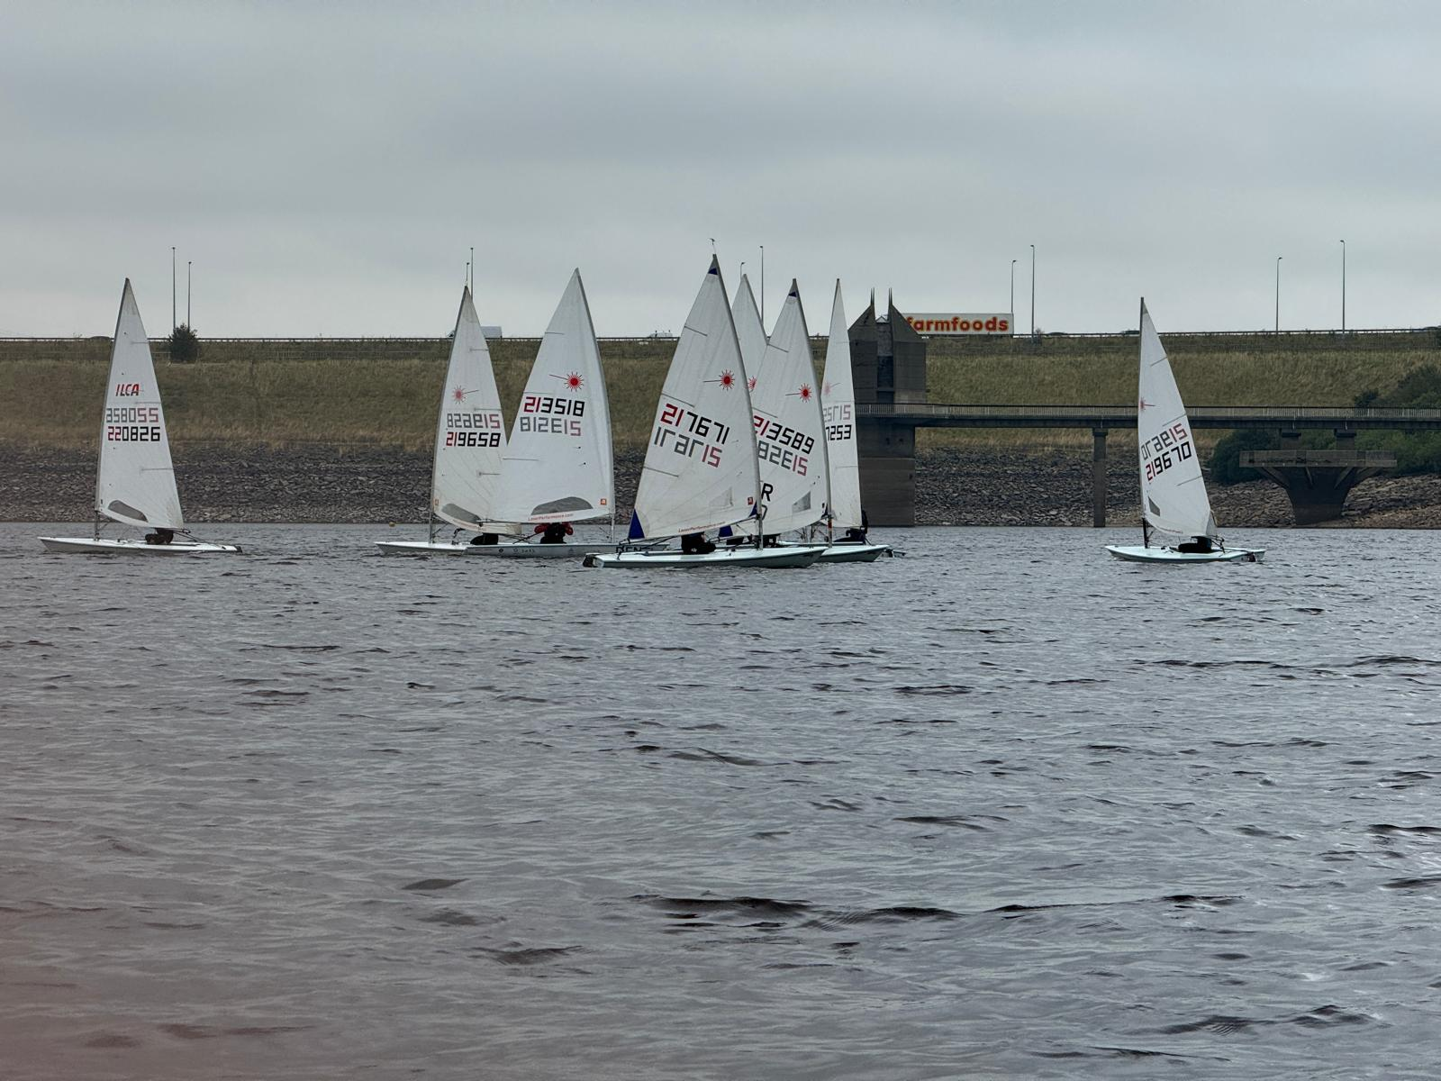
Photos courtesy of members

Slide 3
Scammonden Water Sailing Club
Founded 1970
Clubhouse: The Old Vicarage, Scammonden,
near Outlane, Huddersfield, HD3 3FT
What3words:
Live octagonal weddings
Contents
The Commodore’s Bit page 4
Captain’s Log page 5
Members List 2024 page 7
Club Officers page 10
  Sailing Times page 12
2024 Trophy Winners page 14
2025 Trophy Allocation page 17
Major Trophy Days 2025 page 21
Sailing Programme 2025 page 23
Outline of Duties page 28
SWSC RYA Training Centre page 33
SWSC Sailing Instructions page 39
Paddleboarding page 51
Care of young children page 54
Key dates page 56
Enjoy your sailing at S.W.S.C.
But remember.
SAIL SAFE
Always wear a buoyancy aid
Wear protective clothing suitable for the conditions
Keep a close eye on young children near the water
If you do capsize - stay with your boat
IF IN DOUBT - DON'T GO OUT!!

Slide 4
Commodore’s Bit
Welcome members to the new sailing year at Scammonden.
The Sailing Captain has put together another year of exciting racing and I know you’ll be as keen as me to get into that, but first let’s have a quick look back on 2024.
The Laser fleet continued to thrive and it’s great to see them mixing it up with the RS Aero fleet. There’s been a growth in the number of double-handed boats particularly the Enterprise fleet. This renewed interest was almost perfectly timed to take advantage of the re-introduction of the famous Southport 24 Hour Race following a few years of its absence. The Club invested in a new Enterprise and took up the challenge with Team Scamm going on to record our best result in a long history of competing there – just see all the shields mounted around the bar. It’s an excellent event on both sailing and social front with a good mix of junior and adult members taking part. We will be attending again in 2025 and I’d encourage members of all abilities to join in. Not sailed an Ent ? Not a problem, the intention is to use the boat over the summer to provide coaching to all.
The Club’s other big away day, Filey Regatta, was similarly well attended and despite strong winds and huge swells – which for us pond sailors was a bit disconcerting – SWSC showed well. Again, all who attended enjoyed the weekend and we are looking to take as many of you as possible over there this year.
In May the Club re-introduced the Open Day for the first time since 2019. The weather here too had an impact and kept numbers low, but it was a great to be able to show off the Club’s facilities to would be joiners. And of course, the friendly nature of its members!
The year ahead, of course, brings some challenges to the Club and I discussed specifics at our AGM in November. However, with the sort of spirit, the friendly determination, camaraderie, energy and competence shown by members time and time again, not least in the examples above, I am confident that together, we will rise to meet them.
I would like to thank all committee members for their efforts in helping with the running of the Club during 2024 and as always, the help we get with running the Club either via the committee, working parties or volunteering at Saturday Club all contributes to building the sustainability of sailing at Scammonden.
Have a great year’s sailing.
Neville Senior
Commodore
4

Slide 5
Captain’s Log 2025
Hello everyone and welcome to another year of sailing at Scammonden. If you do not already know me, I am Oliver Boocock and I am the Sailing Captain for 2025.
As always at our annual committee meeting, memberships amongst other things have been discussed. My aim for 2025 is to try and grow Scammonden as a club and bring in more members by utilising our social media accounts and spreading the word. This in turn will hopefully help us to achieve better numbers for our open events which will be great for the club and I know it will satisfy many of your competitive streaks.
I will continue to encourage as many of you as possible to get out on the water and if we see more members joining us this will be a great advantage to the club with less duties, more fun and income to support the club you all know and love.
You will find the sailing programme in the book which you will find has not changed much from previous years, due to it working so well for our members.
Saturday Club will be running the same as previous years. These are great days to bring the kids, for them to have fun and learn the skills of sailing in a more relaxed environment. It would be great to see more attending and supporting Saturday Club this year, everyone is welcome!
Training courses will also be running this year, these are still under discussion and more information on this will be provided in due course once it is all finalised. Courses will be announced on Whatsapp, so for anyone wanting to improve their sailing, knowledge and skills using a power boat, get yourselves involved as this is a great opportunity for all.
I just want to say a big thank you for all the support and hard work (often in peoples own time) that everyone put in last year ensuring that everything has run smoothly and that every detail has been covered throughout, giving us yet another great year.
I hope to see all of you out on the water enjoying our events throughout the year and wish you all a successful year of sailing at SWSC.
Oliver Boocock
Sailing Captain

Slide 6
Sailing Times (All craft)
The SWSC sailing season runs throughout the year from January to December.
Anyone wishing to sail (racing or cruising) must make their intentions known to the OOD before going out on the water.
RACE START TIMES
Saturday Club intends to operate in 2025 from 12th April until 18th October @ 14.00 hrs. each week (see the Sailing Programme for actual dates). During this time members are welcome to social sail but must report to the senior instructor who is running the
Saturday Club.
Sunday 1st Race 13:00 hrs
2nd Race 14:30 hrs
3rd Race 15:30 hrs (No 3rd race for Warm-up or
Frostbite Series)
Wednesday One Race 19:00 hrs (19:30 in May, June and July)
Major Trophy Days 13:00 hrs
Mondays on Bank Holiday weekends 13:00 hrs
On Sunday mornings and Thursday evenings [from May to September only] these times may be used for boat tuning, family sailing etc., provided the safety boat is always manned by two Powerboat Level 2 accredited members.
OOD AND SAFETY BOAT ATTENDANCE TIMES
Time Action
1 hour before race starts OOD and safety team to be at the club to prepare for race.
30 mins before race starts Safety boats to be ready for action, any loose marks put in place, OOD hut open
20 mins before race starts Course posted on the OOD box
Finish: Saturday/Sunday 18.00 hrs Dusk
Wednesday
OOD and Safety Boat duties are managed by the DutyMan system. Turn to page 38 for details of how the DutyMan process works.

Slide 7
2024 Trophy Winners
Scammonden Results
Morgan Giles Trophy – Awarded to the best performance from a dinghy helm in 3 out of 5 major trophy days.
BEN RATCLIFFE
Warren Bottle – Awarded to the best performance for a laser helm in 3 out of 5 major trophy days.
IAN TURRELL
Roaring Fourties Trophy – Awarded to the best performance by a helm aged 40 plus. MIKE GOODWIN
Flying Fifties Trophy – Awarded to the best performance by a helm aged 50 plus.
BEN RATCLIFFE
Golden Oldies – Awarded to the best performance by a helm aged 60 plus.
IAN LEES
Pro-Am Trophy – Most improved sailor in 3 out of 5 major trophies.
NEVILLE SENIOR
Best Away Day – Traveller Trophy
Oliver Boocock & Luke Hartshorn
Best Crew – Craven Shackle
Luke Hartshorn
Best Performance – Pursuit Trophy
Ben Ratcliffe
Best Capsize – Flowerpot Trophy
Ian Turrell
Fastest Enterprise at Scammonden
Oliver Boocock & Luke Hartshorn

Slide 8
2024 Trophy Winners
Trophy Allocation
Ben Ratcliffe
Warm Up Series – Long Haul Trophy
Easter Series – Tower Boy Trophy
Sunday Spring Fleet Series – 1st Mixed Fleet – Scammonden Pot
Caretakers Cup – Caretakers Cup
Fathers Day Trophy – Fathers Day Trophy
Fleet Challenge Trophy Day – 1st Mixed Fleet – Peter Stringer Tankard
Commodores Cup – Commodores Cup
Morgan Giles Trophy
Flying Fifties Trophy
Best Performance – Pursuit Trophy
Ian Turrell
Summer Sunday Series – Marauder Trophy
Captains Day – Barry Haigh Memorial Trophy
Fleet Challenge Trophy Day – 1st Laser – Laser Club Championship Trophy
Warren Bottle
Oliver Hirst
Spring Bank Series – Hornblower Trophy
Oliver Boocock
Sunday Spring Fleet Series – 1st Laser – Lone & Lively Log
Oliver Boocock & Luke Hartshorn
2nd Wednesday Series – Scammonden Cup
3rd Wednesday Series – Thornton Trophy
Mid Summer Pursuit – Oxley Salver
Most Wednesdays – Withens Bowl
Best Away Day – Traveller Trophy
Fastest Enterprise at Scammonden – Scamstone Trophy
Luke Hartshorn
Junior Novice Day - Novice Helm – West Yorkshire Sailing Club Trophy
Best Crew – Craven Shackle

Slide 9
2024 Trophy Winners
Mike, Jack & Lucy Goodwin
1st Wednesday Series – Balmforth Barrel
Presidents Cup – Kenneth Brooke Trophy
Mike Goodwin
Roaring Fourties Trophy
Lucy Goodwin
Junior Novice Day – Junior Helm Female – Pocket Bottom Trophy
Fleet Challenge Trophy Day – Toppers – Yorkshire Building Society Trophy
Late Summer Pursuit – Warren Trophy
Jack Goodwin
Junior Novice Day – Junior Helm Male – Junior Helm Trophy
Chris Smith
Autumn Sunday Series – Single Handed Cup
Seamanship Trophy – Seamanship Trophy
Fastest Lap at Southport -
Charlotte Crawshaw
Junior Novice Day – Youth Helm – Junior Helm Trophy
Jamie Holdaway
RNLI – RNLI Trophy
Ian Lees
Golden Oldies Trophy
Neville Senior
Pro-Am Trophy

Slide 10
2025 Trophy Allocation
1. Series
Warm-up Series | 1st overall | Longhaul Trophy
Spring Fleet Series | 1st Laser | Lone & Lively Log
 | 1st Mixed | Scammonden Pot
 | 1st Junior | Warren Trophy
1st Wednesday Series | 1st overall | Balmforth Barrel
Easter Series | 1st overall | Easter Egg Trophy
Summer Saturday Series | 1st overall | Huccup Trophy
2nd Wednesday Series | 1st overall | Scammonden Cup
Spring Bank Series | 1st SWSC dinghy | Hornblower Trophy
Summer Sunday Series | 1st overall | Marauder Trophy
3rd Wednesday Series | 1st overall | Thornton Trophy
Autumn Fleet Series | 1st overall | Single-handed Class Cup
Frostbite | 1st Laser | Laser Frostbite Trophy

Slide 11
2025 Trophy Allocation
2. Rolling Trophies
Morgan-Giles Trophy | Awarded to the best performance from a dinghy helm in 3 out of 5 Major Trophy Days
Warren Bottle | Awarded to the best performance from a Laser helm in 3 out of 5 Major Trophy Days
Roaring Forties Trophy | Awarded to the best performance by a helm aged 40+ on 1st January 2024 in 3 out of 5 Major
Flying Fifties Trophy | Awarded to the best performance by a helm aged 50+ on 1st January 2024 in 3 out of 5 Major
 | Trophy Days
Golden Oldies | Awarded to the best performance by a helm aged 60+ on 1st January 2024 in 3 out of 5 Major
 | Trophy Days
Pro-Am Trophy | Awarded to the most improved sailor in 3 out of 5 Major Trophy Days
3. Major Trophy Days
Caretaker’s Cup * | 1st overall | Caretaker’s Cup
Captain’s Day * | 1st overall | Barry Haigh Memorial Trophy
Midsummer Trophy * | 1st overall | Oxley Salver
Junior/Novice * | 1st junior | Junior Helm Trophy
 | 1st novice junior | Novice Junior Helm Trophy
 | 1st novice | Novice Helm Trophy
Ladies’ Day * | 1st lady | Pocket Bottom Trophy
* Trophy contributes to the Rolling Trophies

Slide 12
2025 Trophy Allocation
Captain v Commodore | Winning Team | Dam Pot
Seamanship Trophy | 1st overall | Sherry Endeavour Trophy
Challenge Pursuit Day | 1st overall | Carter Trophy
President’s Cup * | 1st overall | Kenneth Brooke Trophy
Fleet Challenge Day | 1st overall
 | Toppers/Lasers/Mixed
RNLI Trophy Day * | 1st SWSC dinghy | Harry Hutchinson Trophy
Ladies’ Coffee Pot * | 1st overall | Ladies’ Coffee Pot
 | 1st dinghy home | Captain’s Scratch Salver
Scammonden Freezer | 1st overall | SWSC Freezer Trophy
Father’s Day | 1st overall | Father’s Day Trophy
Commodore’s Cup | 1st overall | Commodore’s Cup
Personal Handicap Final | 1st overall
* Trophy contributes to the Rolling Trophies
4. Other Trophies
Best Capsize |  | Flowerpot Trophy
Best Crew |  | Craven Shackle
Best Away Day |  | Traveller Trophy
Best Performance Best Filey Result |  | Pursuit Trophy TBC

Slide 13
Major Trophy Days 2025
Caretaker’s Cup * Sunday 13th April, 13:00 start.
Race duration 2 hours minimum. Race will finish when the lead boat crosses the line after 2 hours. All boats complete the same number of laps, except those off PYS greater than 1250 which will do one less.
Challenge Pursuit Day Monday 6th May, 13:00 start.
A 2 hour pursuit race.
Captain’s Day * Sunday 1st June, 13:00 start.
3 races. 2 races to count. All boats race together off PYS.
The Scammonden Cup * Sunday 8th June June, 13:00 Start
A 2 hour pursuit race based on a PYS. Slowest boat to start at 13:00.
Father’s Day * Sunday 15th June, 13:00 Start.
3 races. 2 races to count. Any man who is supporting or has supported a child under 16 is eligible to qualify.
Mid-Summer Pursuit Trophy * Wednesday 18th June, 19:00 start.
A 90 minute race. A pursuit race based on personal handicaps (at least 3 Wednesday results required to obtain accurate PH). Slowest boat to start at 19:30.
Team Racing Sunday 22rd June, 13:00 Start.
Young and old.
Ladies Day * Sunday 13th July, 13:00 Start.
3 races. 2 races to count. All boats race off PYS. Ladies who enter must be over 16 years of age on 1st January 2024 to be eligible.
President’s Cup * Sunday 10th August, 13:00 Start.
3 races. 2 races to count. All boats race together off PYS.
Seamanship Trophy Sunday 17th August, 13:00 Start.
2 races, 1 race to count and a quiz held in the bar after the race. Quiz teams must only be the helm plus crew from any boat to be eligible for a quiz position finish.
Junior/Novice Day * Saturday 23rd August, 14:30 Start.
3 races. 2 races to count. All boats race off PYS. Junior and Novice Juniors must be aged under 16 on 1st January 2024 and Novices must have been sailing for less than 3 complete seasons to be eligible.

Slide 14
Major Trophy Days 2025
Fleet Challenge Trophy Day Sunday 24th August, 13:00 Start.
A 2 hour pursuit race. Any class with 3 or more starters will be awarded a trophy.
Late Summer Pursuit Monday 25th August, 13:00 Start.
A 90 minute pursuit race based on personal handicaps (at least 3 Wednesday results required to obtain accurate PH). Slowest boat to start at 13:00.
Personal Handicap Final Wednesday 3rd September, 19:00 Start.
Handicap based on previous Wednesday evening races (at least 3 Wednesday results required to obtain accurate PH).
Commodore’s Cup * Sunday 14th September, 13:00 Start
3 races. 2 races to count. Boats race together off PYS.
Captain v Commodore Sunday 5th October, 13:00 Start.
Team event picked on the day. 3 races, 2 races to count.
Ladies Coffee Pot * Sunday 19th October, 13:00 Start.
Race finishes when leading and Scratch Salver boat crosses the line after 2 hours. All other boats finish next time they cross the finish line. Results based on average lap times. All boats race off PYS. Scratch Salver for the first finisher.
RNLI Trophy Day * Sunday 2nd November, 13:00 Start.
3 races, 2 races to count. Boats races off PYS.
Entry fees: £5 Adults & £2.50 Juniors (under 18). All funds donated to RNLI.
Open Event – open to visitors.
* Trophy contributes to the Rolling Trophies

Slide 15
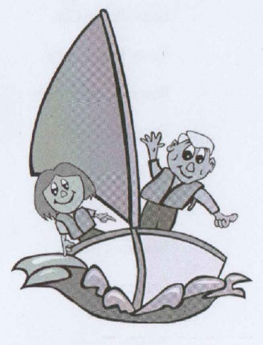
Saturday Club
returns for 2025
at SWSC
Dedicated training days
for juniors and novices alike,
starting Saturday 12th April
Shore and water based activities
If you are interested in joining or
helping out please see
Mike Goodwin(sailing school Principle), Ben Ratcliffe, Ian Turrell, or Paul Cornish

Slide 16
SWSC Sailing Programme 2025
Warm Up & Holiday Series |  | Date |  |  | Races | League Event
Warm Up Series |  | 09-Mar | - | 06-Apr | 4 from 8 | 1
Easter Series |  | 20-Apr | - | 21-Apr | 3 from 6 | 2
Spring Bank Series |  | 25-May | - | 26-May | 3 from 6 | 3
Sunday Series
Spring Fleet |  | 20-Apr | - | 08-Jun | 8 from 15 | 4
Summer Sunday Series |  | 29-Jun | - | 03-Aug | 8 from 15 | 5
Autumn Series |  | 07-Sep | - | 26-Oct | 8 from 15 | 6
Frostbite |  | 09-Nov | - | 07-Dec | 6 from 10 | 7
Wednesday Series
1st Wednesday Series |  | 02-Apr | - | 14-May | 4 from 7 | 8
2nd Wednesday Series |  | 21-May | - | 09-Jul | 4 from 7 | 9
3rd Wednesday Series |  | 16-Jul | - | 27-Aug | 4 from 7 | 10
Trophy Days
Caretaker’s Cup | Sunday | 13-Apr |  |  | 1 from 1 | 1
Challenge Pursuit Day | Monday | 05-May |  |  | 1 from 1 | 2
Captain’s Day | Sunday | 01-Jun |  |  | 2 from 3 | 3
The Scammonden Cup | Sunday | 07-Jun |  |  | 1 from 1 | 4
Father’s Day | Sunday | 15-Jun |  |  | 2 from 3 | 5
Mid-Summer Pursuit | Wednesday | 18-Jun |  |  | 1 from 1 | 6
Team Racing | Sunday | 22-Jun |  |  | 2 from 3 | 7
Ladies Day | Sunday | 13-Jul |  |  | 2 from 3 | 8
President’s Cup | Sunday | 10-Aug |  |  | 2 from 3 | 9
Seamanship Trophy | Sunday | 17-Aug |  |  | 1 from 2 | 11
Junior/Novice Day | Saturday | 23-Aug |  |  | 2 from 3 | 13
Fleet Challenge | Sunday | 24-Aug |  |  | 1 from 1 | 14
Late Summer Pursuit | Monday | 25-Aug |  |  | 1 from 1 | 10
Personal Handicap Final | Wednesday | 03-Sep |  |  | 1 from 1 | 15
Commodore’s Cup | Sunday | 14-Sep |  |  | 2 from 3 | 12
Captain v Commodore | Sunday | 05-Oct |  |  | 2 from 3 | 16
Ladies Coffeepot | Sunday | 19-Oct |  |  | 1 from 1 | 17
RNLI Trophy | Sunday | 02-Nov |  |  | 2 from 3 | 18
Open Meetings
Enterprise Open | Sun | 13-Apr |  |  | 2 from 3
Laser Open | Sun | 07-Sep |  |  | 2 from 3
RNLI Trophy Day (Open) | Sun | 02-Nov |  |  | 2 from 3
Freezer Open | Sun | 28-Dec |  |  | 1 from 1

Slide 17
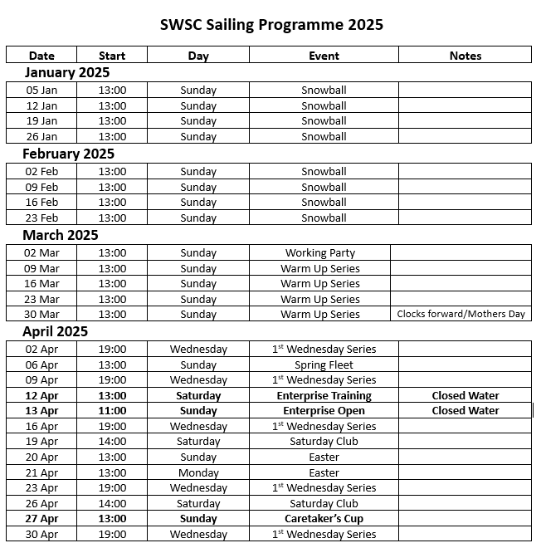
SWSC Sailing Programme 2025
All dates are intended but may change

Slide 18
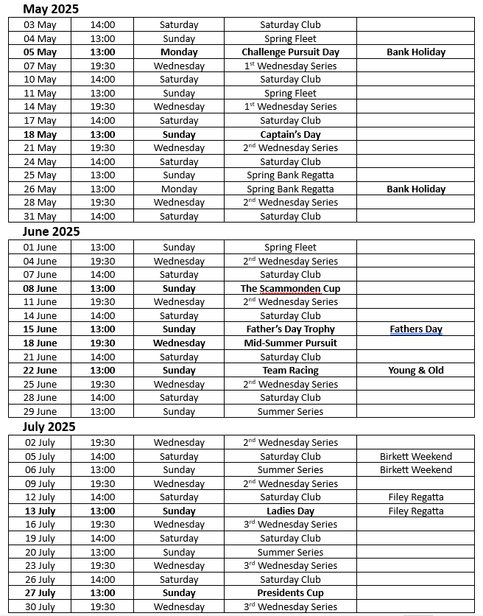
SWSC Sailing Programme 2025

Slide 19
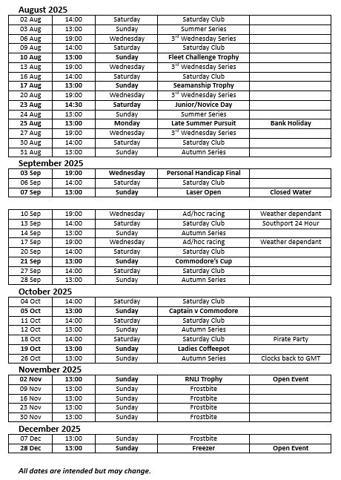
SWSC Sailing Programme 2025

Slide 20
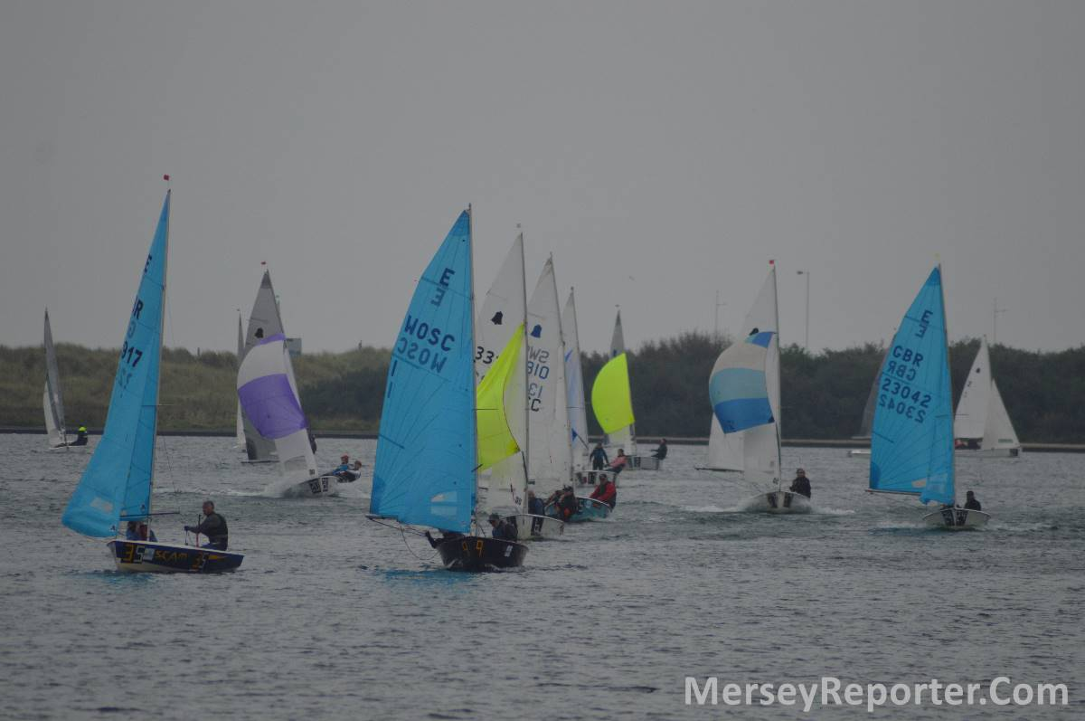
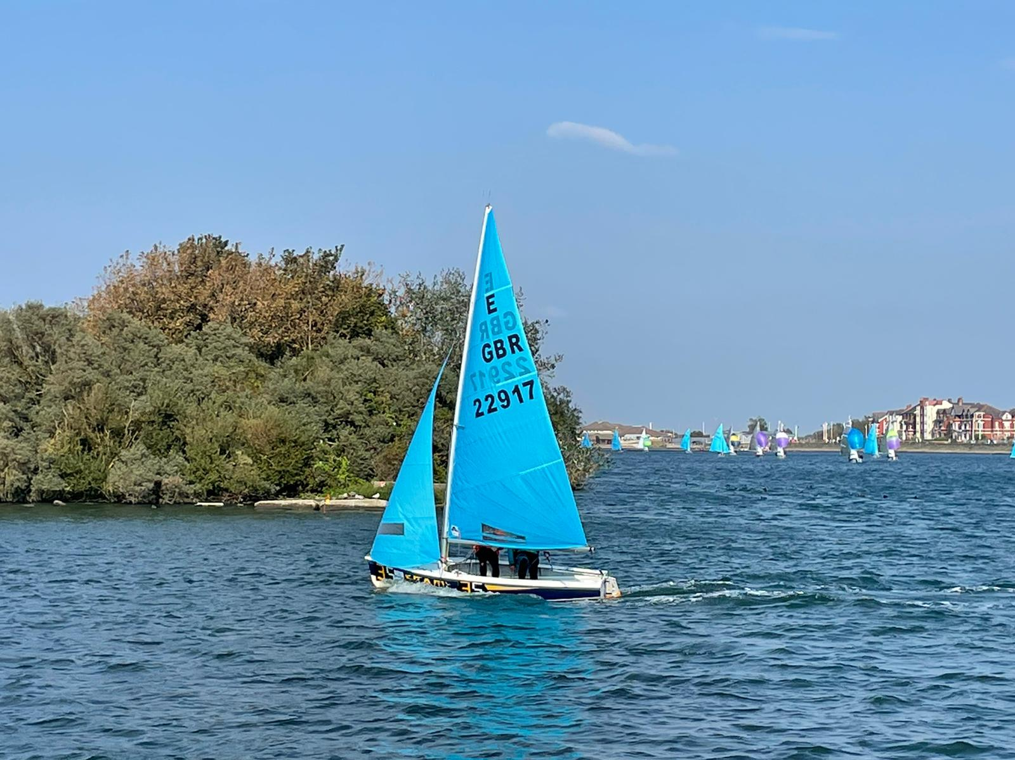
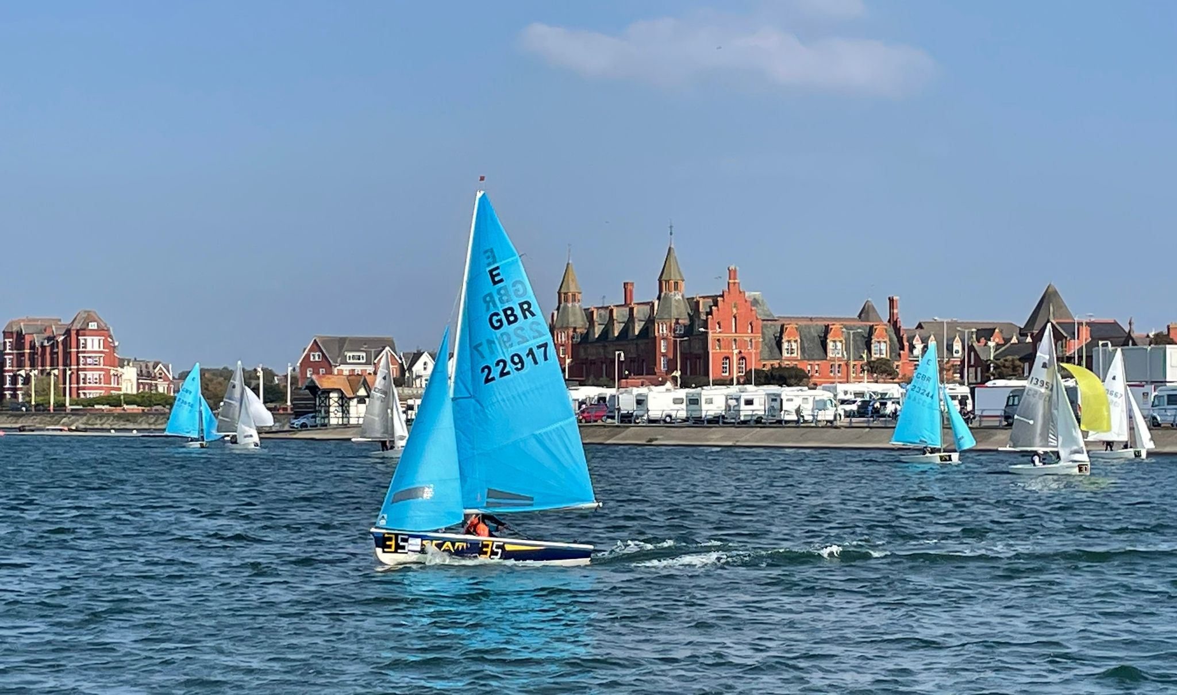
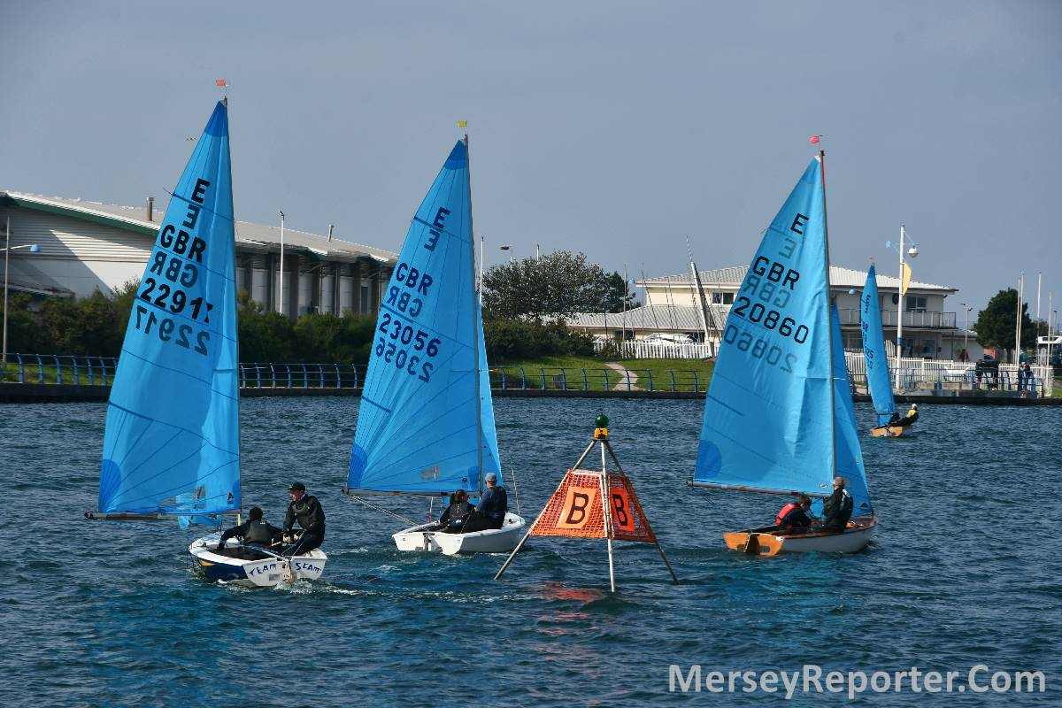
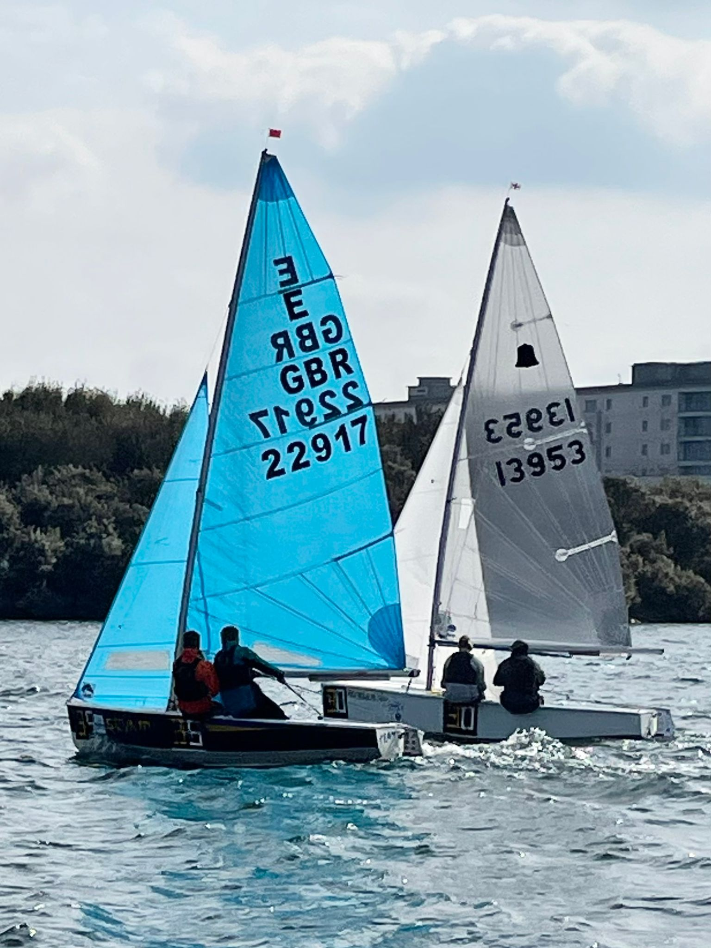
Scammonden’s favourite away day – the southport 24 hour race- photos courtesy of members

Slide 21
Outline of Duties
Duties are allocated to members to facilitate the use of the club by fellow members. The club uses the DutyMan system to allocate and publish the duties. It allows members to swap and volunteer for duties. Notes on DutyMan are available on page 38 of the Yearbook.
It is the responsibility of members to perform the duty allocated or arrange a swap to perform another duty. All officers should confirm their duty on Dutyman or arrange a swap as soon as possible; this significantly reduces the amount of time and effort spent by others to ensure that club members have the support they are expecting on the day.
All sailing duty officers are required to be at the club at least one hour before the sailing is timetabled to begin.
Officer of the Day (OOD)
OOD are timetabled for Sundays and Wednesday evenings.
Overview
Normally the OOD will be assisted by a Safety Officer.
The role is to organise the racing programme for the day with the help of the Safety Officer. Details of managing a race, use of the flags and use of the race box is provided within the OOD box at the club. Should you have any questions regarding operating any of the systems, please contact the sailing captain.
Duty Preparation
A month or more in advance of the duty date check DutyMan and contact the SO and ASO to confirm their attendance on the day.
Assistant Race Officer (ARO)
Assistant Race Officers are timetabled for club Opens and large sailing events.
Overview
The role is to assist the OOD with setting up the day’s racing for large sailing events and club Open events. The role will include collecting monies for an event, managing the collection of entry forms and handing out sailing instructions to participants. The ARO should assist the OOD with setting up and launching the committee boat (Dory) with all the required flags and signals required for the day’s racing.

Slide 22
The DutyMan System
Members will receive several reminders in the run up to the date of a duty unless they choose to switch off reminders.
To speed up the login process to confirm or arrange a swap follow the link from the initial allocation email to your account and then use the ‘bookmark this page’ option to add it to your favourites and you can then log straight in or use the DutyMan link on the club website homepage - https://scammondensailing.com
Don’t leave it to the last minute.
Use the DutyMan website; select as many duties as possible that you can do to get the best possible chance of arranging a swap.
Try phoning those with duties in the near future (phone number on DutyMan), as they may well accommodate your swap if approached personally.
Duties of the Safety Officer (SO)
Your Role
The SO is responsible for providing safety cover for sailors on the water in conjunction with other duty officers on the day.
When conditions warrant an additional assistant Safety Officer, one shall be drawn from the competing sailors. The conditions warranting an ASO could be weather, or competence of participating sailors, or a combination of the two. The OOD or SO may abandon all sailing if no volunteer ASO is forthcoming
Preparation
All sailing duty officers are required to be at the club at least one hour before the sailing is timetabled to begin.
Check the weather forecast and ensure you have appropriate kit including buoyancy aid.
IN AN EMERGENCY YOU MUST BE PREPARED TO GET WET TO HELP AFFECT A RESCUE - WEAR APPROPRIATE CLOTHING.
On Arrival
Get the boathouse/fuel store keys. They are kept in the clubhouse. The bunch you need is attached to the plastic bottle.
Unlock the boathouse.
Prepare Safety Boat
Normally there will be two safety boats in the boathouse; please use the boat best suited for the tasks of the day.
Check fuel levels.
Check that the boat is equipped with a paddle, anchor and rope together with a rope for towing. An emergency knife should also be located onboard.
Liaise with the SDO/OOD and ASO to ensure that the radios are working.

Slide 23
Safety Boat Duty
You must ensure that you are on hand to helm the safety boat at all times.
We ask that duty officers do not cruise around the lake during sailing unless it is extremely windy, in which case subject to the sailors’ abilities and types of boats sailing it may be advantageous to be on the water ready. This is to ensure the club’s fuel costs are minimised.
On Wednesdays and Sundays you will be assisted by an Assistant Safety Officer (Rescue 2). Whenever you are undertaking a rescue, there should be two persons within the safety boat. It is impractical and unsafe to undertake an effective assistance as a single crew.
All occupants of the safety boat must wear a buoyancy aid.
Where there is no OOD or SDO on duty, the SO can impose restrictions on activities or stop all sailing if conditions are such that it is deemed to be unsafe for members to be on the water. If in doubt discuss with the members at the club during the day; there will probably be somebody there who is more experienced than you who will be more than willing to advise or help out.
Criteria to consider:
Weather conditions
Number of boats sailing
Experience of sailors
Number of people who can be asked to help out; e.g. members present but not sailing could help out in another safety boat?
On Departure
Return the boat to where you found it and return equipment to the “as-found” condition.
The boat should be mopped out if dirty.
Ensure that the water gate is closed and likewise secured.
Do not remove any keys or safety kill cords. They must be left in place on the safety boat ready for the next user.
If other members wish to continue sailing after your departure ensure that there is a nominated qualified person to take on the SO role and take on the responsibility of locking up if need be.
When a Boat Capsizes
Most people cope very well when they capsize, after all it is part of sailing. However, do not assume that all is well.
Even the most experienced sailors can get into difficulties during a capsize or during recovery. You MUST go to a capsized boat as soon as possible after it has capsized to ensure that all is well.
(cont..)

Slide 24
Do not assist unless asked, racing competitors usually wish to finish a race. However, keep a careful eye on what is happening, people use up a lot of energy very quickly, particularly if the water is cold.
If you consider that people are becoming too tired or cold you should encourage them to receive help. Young children should be taken onto the safety boat if you are at all concerned about their welfare; they get cold very quickly because of their lower body mass. Take anyone who is visibly cold - shivering - ashore and leave the dinghy until later.
The inadequately dressed sailor, not wearing a wet suit in cold or near freezing water is at considerable risk. The figures are - 4 minutes in freezing water before chill sets in - 20 minutes in a wet suit.
When approaching someone in the water do so by travelling up wind, slow down and turn the engine off as soon as you are in contact with the person to be taken on board unless there is a risk of being blown aground. If upwind of the dinghy, do not drift down onto them.
Remember as you come alongside that the propeller on the back is potentially lethal, this is where a second person can be of considerable help, they can assist persons into the boat whilst you control the engine safely. If in doubt turn off the engine.
In the event of several capsizes (which very often happens in a squall) you will need to assess who needs your help most. In this situation you must visit each capsize and ask if everyone is all right. Use your judgement to ascertain whether it might be wiser to pick up those who are in the water and leave the boat until later, so that you get to other capsizes quickly.
Your priority is the safety of people not the recovery of boats.
Inversion – Trapped Crew
In the event that a dinghy has completely inverted and you believe that there is or may be someone trapped underneath it, the most important thing to do is to get the dinghy upright.
Throw the anchor overboard from the safety boat.
Climb onto the upturned hull.
Holding the tip of the centreboard/daggerboard and with your feet on the hull/deck join, lean backwards as far as possible to start to pull the boat upright.
If this does not quickly prove effective:
Take the tow line which has a carbineer clip attached to one end over the top of the dinghy and clip it to the further shroud.
Return to the safety boat, tie off the tow line, up-anchor and seek to pull up the dinghy using as much power as is necessary.

Slide 25
First Aid and Medical Support
Once ashore other people will probably take over, either First Aiders or
Doctors.
Usually, a shivering capsize victim can be revived by a hot shower, dry clothes and a hot cup of tea.
In the event of more serious incident or injury and in the absence of a first aider contact either 111 or 999 for advice and follow the club serious incident procedure if need be; a copy is available in the clubhouse.
Clubhouse Address: The Old Vicarage, Scammonden,
near Outlane, Huddersfield, HD3 3FT
What3words:
Live octagonal weddings

Slide 26
Scammonden Water RYA Training Centre
Training is an important aspect of our club activities. As a recognised Royal Yachting Association (RYA) Training Centre, Scammonden Water Sailing Club is able to offer club members training and coaching sessions on site. The Training Centre caters for both adult and junior training. Our sailing season runs between mid-April and mid-October during which beginner, intermediate and advanced sailors are welcome to come along and improve their skills.
As a club, we are keen to welcome those new to sailing, as well as those who have sailed previously. We are also eager to attract those who are confident and proficient sailors. We can also accommodate training during the winter months, weather permitting, although this is not recommended for beginners. Sessions are run within the framework of the RYA schemes and, where applicable, can be tailored to suit individual sailing needs. We are able to sign log books, and on completion of each course to the required standard, issue RYA certificates for the courses to which we are accredited.
The pillars of our success as a training centre are the instructors themselves. All of our courses and coaching sessions are organised and run by individuals or a group of dedicated, experienced and friendly instructors. We currently have six RYA qualified instructors, the majority of whom are volunteers:
Courses
As we are a voluntary run centre, not a commercial training establishment, courses are run according to demand and available resources. Therefore, please contact the Training Centre Principle if you are interested in an aspect of training which has not been included. Course details, scheduled dates, availability, costs and booking details can be found on the club website - scammondensailing.com/training-centre. Buoyancy aids are provided free of charge if needed but we cannot provide wetsuits or other waterproof clothing.
Ben Ratcliffe - Chief Instructor, Race Coach and Powerboat Instructor
Ian Turrell - Senior Instructor and Powerboat Instructor | Paul Cornish - Dinghy Instructor
Mark Clarke - Senior Instructor & Powerboat Advanced Instructor Mick Hunter - Dinghy Instructor & Powerboat Advanced Instructor

Slide 27
Adult Training
Adult training follows the RYA National Sailing Scheme syllabus. A list of the courses on offer (subject to demand and availability) can be seen below. For further details see the RYA website -
http://www.rya.org.uk/courses-training/Pages/hub.aspx
Dinghy Level 1 – Start Sailing
Dinghy Level 2 – Basic Skills
Dinghy Level 3 – Better sailing
Dinghy Start Racing
Dinghy Seamanship Skills
Dinghy Performance Sailing
Dinghy Sailing with Spinnakers
Where the requirement is to undertake 16 hours of training most of the courses are held over four consecutive (weather permitting) Saturday afternoons. Level 1 courses are run in Wayfarer dinghies while Level 2 courses are run in both Wayfarers and single -handed Topper dinghies. The Powerboat and Safety courses are run over two full days, incorporating theory and practical work. The First Aid courses are run over two twilight sessions.
Our intention as a club has been to provide the best training and resources to enable all of our members to develop their skills in both sailing and powerboats. This includes becoming more competent using a powerboat and to gain a recognised RYA Certificate to support this new skill. Throughout the last few years many members have taken these opportunities.
As it is a fundamental requirement for the club to provide competent safety boat cover while we are using the water, we intend to continue to run both the Powerboat and Safety Boat courses during the 2023 season. I encourage every member to take the opportunity to benefit from these courses so that we are better able to safely operate and manage our safety boats.
Saturday Club
Saturday Club is led by our Senior Instructor, Ben Ratcliffe, with our dinghy instructors running aspects of the sessions and modelling good practice. It caters for young sailors roughly in the age range 8 to 16 years. In 2025 the Race Academy season begins on Saturday 12th April and is scheduled to run until 18st October from 2.30pm until 5.00pm most Saturdays. A full list of dates is provided in the sailing calendar and any changes will normally be communicated via WhatsApp.

Slide 28
The Saturday training syllabus follows the RYA Youth Sailing Scheme Stages 1 to 4 programme and each training session counts towards one of the RYA Junior Stage certificates. More advanced junior sailors can also qualify for other RYA modules. Usually, a minimum of seven training sessions (a minimum of 16 hours) are required for any RYA Junior Stage qualification, and the certificate will be issued on successfully completing one of the sailing skills assessment days. To join Race Academy a junior must be a member of Scammonden Water Sailing Club and for child protection purposes we also require that at least one adult parent/carer remains at the club when their child is attending the sessions.
How can you help?
We would be very grateful for any help that you may be able to offer to ensure our training centre remains a success. Help would be particularly appreciated to man the safety boats (Powerboat Level 2 required) and to assist with rigging and launching the dinghies. Please contact a member of the team if you are able to help.
SWSC Training Centre Principal

Slide 29
About SWSC
SWSC is a private club which is owned and run by its members for their benefit and to promote the sport of sailing in the community.
All members are encouraged to bring their families and friends to enjoy the facilities. The club’s biggest asset is its friendly atmosphere and many of our members enjoy family holidays and travelling to events all over the UK.
We enjoy a large water in a beautiful setting with excellent facilities and ten classes of membership to cater for all ages and requirements.
Club racing is organised for Wednesdays during the lighter months, Saturdays and Sundays throughout spring, summer and autumn and Sundays only in the winter. The racing and social events calendar is published in the club Yearbook with reminders and changes usually communicated via the club WhatsApp groups. If you think you are not included in the WhatsApp groups, just ask a member of the committee.
The club has invested heavily in recent years in youth training and continues to make improvements to the clubhouse and the grounds.
If you bring guests, please sign them in using the visitors book in the galley. Your guests need to be aware of club rules and disclaimers. There is no charge for guests using your own boat however a donation is appreciated (tin in galley or bar).
For guests, i.e. non-members, in their own boat there is a £15 per day fee (please leave with OOD). Maximum 6 guest visits a year.
Open events
The only provision for day membership without being introduced as a guest of a member is to a club Open event. Helms and crews entering Open events become members of the club for the duration of the event and are subject to club rules.
SWSC website (www.scammondensailing.com)
The website is a reliable source of club information, including online copies of all our official documentation, club events, the sailing programme and a popular sailing kit ‘For sale’ page. There is also a regularly updated results page so you can always see who is winning what!
It makes sense to sign up for ‘email notifications’ (see the link on the right-hand side of the web page). Once you are signed up you will receive an email prompt whenever the homepage is updated with the latest news - it means you never miss out.

Slide 30
Interactive Duty Roster (DutyMan) and completing your duty
Like all sailing clubs, members are required to volunteer to help run the club.
At SWSC you will be required to complete a number of duties during the sailing year, this will be either as Officer of the Day (OOD) or as part of the safety boat crew. If you are rostered for a duty then you are expected to attend for your duty one hour before the start of the race to prepare.
If you are rostered for a duty but unable to attend, it is your responsibility to ensure that you swap the duty. You can swap via the DutyMan website – there’s a direct link on the scammondensailing.com homepage - or by contacting other club members.
All contact details are available on DutyMan and in the yearbook.
It is the responsibility of the OOD to ensure that all those rostered are able to attend. The Race Officer is also in charge on the day of the duty for racing and the safety of all those on the water.
For those who have never done a duty before, or who are inexperienced, we will try to ensure that you are placed with more experienced club members. We will also aim to ensure that at least one member on duty has Powerboat Level 2.
DutyMan, the club’s duty roster, was successfully introduced during 2012. This is a live and interactive duty roster which helps members to manage their duties more effectively. This includes confirming availability, swapping duties online, volunteering and recording dates when you are unavailable.
DutyMan is simple to navigate but if you need a little help there is a ‘How do I’ link at the right of the upper navigation bar on the home page. This explains how to use the system and will answer most of your technical questions.
If you haven’t received a welcome email containing a user name and an initial password then please contact Paul Cornish. You can change your initial password when you log into DutyMan.
For those worried about their contact details being made available online there are privacy settings when you log in. Contact details are not shown until a member logs into the roster. This means that your phone number cannot be seen by anyone who is not a SWSC member.
If you have any questions about DutyMan or have not received log-in details, please contact the sailing captain.

Slide 31
Dinghy Park Rules and Map
Your boat park number will be issued/confirmed on cleared payment in full of your membership fees.
Before any new or replacement craft /equipment is placed in the dinghy park, please obtain consent from the Sailing Captain or the Membership Secretary.
Consent for placing a boat in the park applies to both new and existing members.
You should place your current year boat-sticker (with your name or member number written on it in permanent marker) so that it is visible with the boat cover on.
The best positions are on the transom or front of the mast if left stepped.
Craft not displaying the current year’s sticker may be removed without warning.
Please check your craft regularly, particularly when high winds are forecast..
All trailers must be marked with owner details.
Ensure your craft is securely fastened to the anchorages provided when left unattended.
Always try to keep your trailer in your allocated berth.
Road trailers left on site should be locked or otherwise immobilised.

Slide 32
SWSC Sailing Instructions 2025 Issue 28 - Ollie Boocock
STATUS
(i) These Sailing Instructions replace and supersede all previous issues of Sailing Instructions and are operative for all club races. Where a conflict exists between the club sailing instructions and the IYRU Rules, the sailing instructions will prevail.
(ii) Separate instructions may be issued for Open Meetings, Regatta and Interclub races.
(iii) Where reference is made to Boats, this also covers Sail Boards unless specifically referred to as a board or a dinghy.
SECTION A. Standing Orders (Sailing rules which always apply)
1. To be eligible to sail and race persons should be fully paid-up members of Scammonden Water Sailing Club, and dinghies must be 18 ft or less in length.
2. Adequate Personal Buoyancy (inflated if of that type) shall be worn at ALL times when on the water. There is no exception to this order which includes safety boat crews. Just a wet suit or dry suit is not sufficient.
3. Any person on the water is subject to the direction and control of the O.O.D. and safety crews at all times. The safety boat coxswain has authority to order a person to abandon his boat and be taken aboard the safety boat.
4. No sailing is allowed unless a safety boat manned by a capable person is in attendance. (confirmed by the club Burgee flying over the O.O.D. box).
5. All boats must pass the club's annual buoyancy test before sailing at Scammonden.
Boats must be disinfected at each arrival at the club.
Boats must have third party insurance cover of at least £5 million.
Non-members may sail providing a day’s sailing fee has been paid and declaration of third-party insurance cover to a minimum value of £5million made and signed. They are not eligible to qualify for any series or trophy.

Slide 33
All boats sailing shall be subject to direction and control of the Sailing Committee and the O.O.D., but it shall be the sole responsibility of each boat to decide whether or not to sail or to continue to sail.
All boats racing have right of way over all boats under training and all boats cruising.
SECTION B. Racing Rules
Except where modified here in races will be sailed under the rules of the I.Y.R.U., the prescriptions of the RYA, the Sailing Instructions and the rules of each class concerned.
2. ELIGIBILITY TO RACE
(i) Before the first race of the day in which a competitor
wishes to compete he must extract his buoyancy test card
from the file in the O.O.D. box and present it to the O.O.D. in
the receptacle provided. This is the only means an O.O.D. has
of identifying starters.
(ii) Each boat must produce a measurement certificate on
request after racing at Scammonden for the first time and all
prize winners must on request produce valid measurement
certificates before being eligible for their awards.
(iii) Any dinghy of the centreboard type up to 18' overall length with a recognized Portsmouth Yardstick Rating will be
eligible to race at Scammonden.
(iv) Any Sailboard conforming to UKBSA racing divisions will be
eligible to race at Scammonden.

Slide 34
3. BOATS QUALIFYING AS STARTERS
(i) Only those boats will be counted as starters that have conformed with 2 (i) above and are off the shore and afloat before their starting signal.
(ii) Unless three or more boats in any one fleet qualify as starters as
above, boats in this fleet shall start with the mixed fleet for this race.
However, to keep the lights/flags sequence for other fleets, the
normal starting signals will be made and a dummy start introduced.
For special scoring rules that apply when a fleet races with the mixed fleet see Rule 8.ii.
4. COURSES
(i) Courses shall be displayed at the O.O.D. box at least 15 minutes
before the starting signal of a race. Courses set shall be a standard
course unless an alternative is approved by members of the Sailing
Committee present. Courses for major trophy days must be approved by members of the Sailing Committee.
(ii) The course for boats with a PY greater than 1200 must be set at the same number laps as the course for the Main Fleet, but maybe shortened at the Race Officers discretion if significantly behind the main fleet.
5. THE CLASSES TO RACE AND CLASS SIGNALS
(i) These tend to change from year to year and may be different on
Trophy days, but an uptodate list of the order of starts of classes
and their Warning, Preparatory and Start signals is always available
in the O.O.D.'s box. The warning signal is the Class Flag signal for any particular Class. For order of starts see the Appendix attached.
(ii) In exceptional circumstances a fleet may start late at the discretion of
the O.O.D.
6. STARTING AND FINISHING LINES
(i) STARTING
The starting line will be either:
a) the extension of a line through two stationary posts with mark at or near its outer limit called the ODM and a mark at or near the inner end of the line called IDM and boats shall pass between these marks when starting. Either or both of these marks may be omitted at the O.O.D.'s discretion.

Slide 35
or
b) a line between a mark and a staff on the committee boat or shore station.
c) or a line between two marks.
(ii) FINISHING
The finishing line is formed by a straight line joining the Red/ White transit pole and the orange pole with the wind vane on the top. When required the finishing line may be between a staff on the committee boat or shore station and adjacent buoy, and such a line shall be set at right angles to the direction of the course from the last mark.
(iii) STARTING AND FINISHING
In all cases the starter or finisher shall sight along the line formed by the outside of the two posts, or marks, on the
opposite side from which the boats are starting or finishing.
7. SIGNALS
Normally, all signals are accompanied by a sound signal but timings should be taken from the visual signals. (A sound signal is a single tone noise such as a horn, klaxon or gun fire). All sound signals for recalls will be made with the same sound source as the starting signals.
(a) The Starting Signal
The starting signals will be a series of different coloured lights and sound signals as follows:
5 minute warning signal (1 light on)
4 minute warning signal (2 lights on)
1 minute warning signal (3 lights on)
0 minute warning signal (reverts back to 1 light)
Alternatively, flag signals may be substituted for lights. The Preparatory Signal for the first class to start shall be left flying or displayed until the last class has started. The Warning Signal for each succeeding class shall be broken out or displayed at the Preparatory sound Signal of the preceding class.

Slide 36
An order of signals would be:
(i) Break out the Warning flag (Class flag) for Class A. After the time interval (e.g. 5 minutes)…
(ii) Break out the Preparatory flag 'P' (Blue with a white centre) for
Class A and the Warning flag for Class B. After the time
interval…
(iii) Lower the Warning flag for Class A (their start) break out the
Warning flag for Class C. After the time interval…
(iv) Lower the Warning flag for Class B (their start) and break out the Warning flag for Class D.
(v) ...and so on. For the last class to start lower both the Warning
and Preparatory flags at the start.
All the above signals shall be accompanied by a single sound
signal.
(b) Individual Recalls
Individual recalls shall be signalled by a single sound signal and in the case of a flag start the class warning signal may be flown at half-mast. The responsibility for starting correctly shall rest wholly with the helmsman of the boat concerned, irrespective of whether or not sail numbers are called.
(c) General Recalls
General Recalls shall be signalled by the breaking out of the I.C. flag 1st substitute (triangular yellow with blue border) or by all lights showing simultaneously. Either signal shall be accompanied by two sound signals. The full start sequence will be re-started as soon as possible.

Slide 37
(d) Shortening Course
(i) Shorten course signals shall be made before the leading boat commences her last leg.
(ii) At the end of a round: I.C. flag 'S' (White with Blue centre) above the Class flag flown at the O.O.D. box will indicate that the race will finish at the end of the round being sailed.
(iii) At any mark of the course: I.C. flag 'S' displayed above the Class flag from the committee boat. The race will finish on the line between the committee boat and the mark.
At the discretion of the OOD the limits of the finish line may be between the red and white pole (outside OOD box) and any mark of the course,passing through the mark if required. The finish mark will be passed on the same side as indicated in the course.
(iv) When either of the above signals is made without a Class flag the signal applies to all classes racing.
(v) The course for boats with a PY greater than 1200 may be shortened during the race at the discretion of the OOD by flying IC flag 'E' (Red and Blue halved). This procedure may not be used for committee boat starts unless the start and finish are at the same location.
All the above signals shall be accompanied by two sound signals.

Slide 38
(e) Postponement Signals
When any of the following signals is made without a Class flag the
signal applies to all classes. The change of course flag 'Q' (yellow
square) may also be included. The postponement signal is the I.C.
flag Answering Pendant (Red and White vertical stripes).
(i) When the Answering Pendant (AP) is flown over a Class signal the scheduled time of the start is postponed. The Warning signal will be made one minute after this signal is lowered. (One sound signal shall be made with the lowering of the AP).
(ii) When the AP is flown over the letter 'A' over the Class signal the
scheduled race is postponed to a later date. The future time and
date of postponed races will be given by notice from the Captain
on the clubhouse board at least 7 days before the new date.
All the above signals shall be accompanied by two sound signals.
(f) Cancellation and Abandonment Signal
When the I.C. flag N (Blue and White chequers) is flown over a class signal the designated race is cancelled or if in progress abandoned. When flown without a class flag the signal applies to all classes. Three sound signals to be made.
(g) Change of Course Signal (When a course already set for a race is to be changed).
(i) The change of course signal is the I.C. flag 'Q' (Yellow square) and
when flown alone means that the change of course affects all
classes not yet started. When flown over a class signal means that
the course for the designated class only has been changed.
(ii) The course can be changed from the one previously set for the race
at any time up to 15 minutes before the fleets affected Starting
Signal without need for postponement. After 15 minutes before
the Starting Signal the starts of the fleets affected must be
postponed so the new course is displayed for at least 15 minutes
before the first affected start.
The above signals shall be accompanied by two sound signals.

Slide 39
8. SCORING SYSTEM
(i) In each points race scoring will be as follows:
First Place 1 point
Second Place 2 points
Third Place 3 points
Fourth Place 4 points .... and so on
(ii) In the events of boats who could not make a fleet starting with the mixed fleet as provided for in Rule 3.ii, their overall result from that race shall count to their own fleet series. These boats' positions shall then be removed from the Mixed Fleet results and the Mixed Fleet boat positions scored as if these boats had not taken part.
(iii) A boat retiring will be awarded points equal to the number of starters in the race plus 1.
(iv) A boat that is a nonstarter but has conformed with 2(i) & 3(i) will be entered on the result sheet as D.N.S. and will NOT be awarded points for that race.
(v) A boat disqualified will be awarded points equal to the number of starters in the race plus 3.
(vi) Points Series
The number of races to qualify for all series will be as published in the Sailing Programme section of the club's annual yearbook. Any change to this qualification will be clearly written on the Series’ results sheet displayed on the results notice board in the club house.
(vii) Ties
When there is a tie on total points between two or more boats the tie shall be resolved in accordance with IYRU Rule A 2.3 (most firsts, seconds etc.)
(viii) Results
Results should be calculated and posted by the OOD on the relevant notice board as soon as practical after the end of the day's racing.

Slide 40
(ix) If more than one rig is used during a series then the lowest PY rig will count towards all results for that series.
(x) Average points for doing duty during a series will only count if the series lasts for more than 2 weeks.
(xi) If 1 lap is completed on a trophy day, then it will be classed as being competed, and the results will stand.
9. TIME LIMITS
All finishers will receive a sound signal. Boats not finishing within 30 minutes of the leading boat finishing (on corrected time) will be deemed to have retired.
10. RETIRING FROM A RACE
Competitors must report their retirement to the O.O.D. within 15 minutes of the last boat finishing in that race. Failure to do so may result in disqualification.
11. OBSTRUCTING STARTER’S VIEW
If any boat, having completed the course, returns over the finishing line and obstructs the starters view so that he cannot determine the order in which two or more boats cross the line, the other boats shall be deemed to have tied, and the offending boat may be disqualified.
12. PROTESTS
(i) Supplies of protest forms are available in the O.O.D.'s box. The
completed form should be given to the O.O.D. who will convene a
hearing. If the O.O.D. is not available, any member of the Sailing
Committee will accept the protest form.
(ii) The O.O.D. shall be notified as soon as practical of a boat's intention to protest.

Slide 41
(iii) The protest shall be made in writing and handed to the appropriate
official within 45 minutes of the protesting boat finishing her
last race of the day. No fee is required.
(iv) Every effort will be made to hear protests on the same day. Parties
and witnesses are requested to attend at the committee room at
1800 hours (unless notified otherwise) on the day the protest is
lodged, when the protest will be heard (if possible) or a date for
later hearing arranged.
(v) Any notification which the Sailing Committee may be required to give to boats involved shall be deemed to be given if posted on the club notice board 6 days beforehand.
(vi) The responsibilities of the Sailing Committee for hearing and deciding protests shall be delegated, pursuant to IYRU rule 89 to a subcommittee of selected protest committee chairmen. If the incident under protest involved serious damage to any involved craft or persons then the protest committee must be chaired by either the Sailing Captain or in his absence by the Vice Sailing Captain, another member of the Sailing Committee must also sit on the committee. At a hearing, two shall be a quorum and any member of the club shall be eligible to be a member of a protest committee. The meeting shall be chaired by one of the selected Chairmen.
(vii) After a protest the completed form should be filed in the black
folder in the clubhouse.
13. 720 degree TURNS, ALTERNATIVE PENALTY
(i) The 720 degree turns rule, as provided in Rule 44.2 of the RYA rules, shall apply instead of disqualification for infringement of a rule in Part 2 (the right of way section) of the RYA rules.
(ii) Any boat who gains an advantage by committing an infringement and then performing a 720 may be protested by the infringed boat and subsequently disqualified.

Slide 42
(iii) Any boat who gains an advantage by committing an infringement of Rule 31 (touching a mark ) may exonerate herself under Rule 31.2 by completing a 360 degree turn.
14. CHANGES TO SAILING INSTRUCTIONS
The Sailing Committee may change the Sailing Instructions by written notice not later then half an hour before the start of a race. Verbal instructions shall not be given.
When a change to the Sailing Instructions has not previously been published to competitors the I.C. flag Pendant 5 (Yellow and Blue vertical) shall be flown for at least 30 minutes before the start of the race affected. Two sound signals shall be made.
15. OWNER CHANGING BOAT
For the purpose of scoring it is the boat/helm combination that counts. Members changing class of boat during a series must notify the Sailing Committee in writing giving the date of the change and the old and new sail numbers. Points scored for the current series will then be awarded to the helmsman.
A helm must however qualify in the same class for Major Trophies to
be eligible for the Rolling Trophies.

Slide 43
Your advert could be here
Advertise in the 2026
Scammonden Yearbook
For further details on
advertising in the
yearbook contact any
member of the
SWSC committee

Slide 44
Paddling update 2025
Welcome to a new year of paddling at Scammonden.
We are looking forward to seeing you on the water throughout the year.
As a club we hold events throughout the year including our start up and working party in March and our prize giving event in November. We would love to see you there.
The water is available from dawn until dusk 7 days a week. Please take note of the below instructions.
If you have any questions or suggestions, then please feel free to speak to me.
Happy paddling.
Paul Cornish
Paddling Captain

Slide 45
Paddling Times 2025
7 days per week dawn until dusk.
No paddling in the dark.
Safety boat cover is available during the following periods.
Wednesday 6:45pm until 8:15pm (April – August)
Saturday 2pm – 4pm (April – October)
Sunday 12:30 – 5pm (April – October)
12:30 – 3:30pm (November – March)
The bar is available at the end of the above sessions, should paddlers wish to have a post paddle drink.
Camping and the barbeque are available to all members if the committee is made aware

Slide 46
Paddling Instructions – Issue 4 – 2025
STATUS
These Paddling Instructions replace and supersede all previous issues of Paddling Instructions and are operative for all members.
Standing Orders
To be eligible to paddle, persons should be fully paid-up members of Scammonden Water Sailing Club and be carrying appropriate membership ID at all times.
Adequate Personal Buoyancy (inflated if of that type) must be worn at ALL times when on the water. There is no exception to this order which includes safety boat crews. Just a wet suit or dry suit is not sufficient.
All boards must have leashes attached and in suitable condition. Leashes must be worn at ALL times when on the water.
Any person on the water is subject to the direction and control of the O.O.D. and safety crews at all times. The safety boat coxswain has authority to order a person to abandon their craft and be taken aboard the safety boat.
When dinghy racing is taking place on the water, paddlers must ensure they avoid the race area, especially at the start of races.
No paddling on the water unless paddling with a buddy, or there is a safety boat manned by 2 people on the water. (Indicated by the club burgee flying over the O.O.D. hut). All paddlers must ensure that they have a designated buddy and carry a whistle / mobile phone at all times.
Boards must have adequate 3rd party insurance in place of at least £3m. This will be confirmed when joining.
All boards paddling shall be subject to direction and control of the Committee and the O.O.D., but it shall be the sole responsibility of each paddler to decide whether to paddle or to continue to paddle.
Other information / tips
When arriving or leaving the club all gates must be closed and locked. Codes are given out when joining.
The site must be left in the same condition as it’s found. Any issues must be reported to a member of the committee. As members of the club, you will also be asked to get involved in any ongoing maintenance of the site.
Be aware of your surroundings. The reservoir is deep, cold and there is a current due to the pumps that run at each end of the lake.
Paddling on the water between sunset and sunrise is strictly prohibited.
You must check the weather forecast prior launching and not launch in high winds.
Ensure that appropriate clothing is worn to suit the time of year and be aware that the water remains cold even during the height of summer.
There is a WhatsApp group for the paddlers where you can communicate with other members.

Slide 47
The Care of Children and Young People at SWSC
The club recognises the importance of caring appropriately for children and young people using our facilities and has a policy to promote their wellbeing and protection.
It is recognised that incidents of bullying and abuse at sailing clubs are rare but current practice suggests that sailing clubs should possess a simple and robust child protection policy.
We follow the guidelines published by the Royal Yachting Association (August 2003) and endorse the following:-
1. Policy Statement
The child’s welfare is paramount.
All children whatever their age, culture, disability, gender, language, racial origin, religious belief and sexual identity have the right to
protection from abuse.
All suspicions and allegations of inappropriate behaviour will be taken seriously and responded to swiftly and appropriately.
As defined in the Children Act 1989, anyone under the age of 18 years should be considered as a child for the purposes of this policy.
2. Club Members’ Responsibilities
Parents are to be responsible for their own children at the club and to supervise them appropriately.
On the water, members are expected to act with foresight and
sensitivity when encountering young sailors undergoing training.
Trainers must be continually aware of the importance of trying to keep them out of the way of boats which are racing.
When children are attending on their own, members are to respect the area designated for their use in the changing rooms.

Slide 48
Members are expected to avoid putting themselves in potentially risky situations, for example, by waiting for children to finish using shower and toilet facilities. Trainers are responsible under the policy for designating appropriate adults to supervise children in these facilities.
Any allegations and concerns about abuse of children should be
reported to the club’s Children and Young Person’s Officer as soon as possible.
3. The Club’s Responsibilities
We undertake to scrutinise the credentials of all club sailing
coaches.
We have appointed a Children and Young Person’s Officer to
promote their welfare and use the RYA Guidelines to investigate any
allegation of abuse.
This officer and the club committee will seek to keep up-to-date with developments in good practice in child protection matters.
We will ask all parents of children training with the club to sign a
consent for emergency medical treatment and if photographing
them sailing.
The Children and Young Person’s Officer is Jacqueline Crawshaw
07748 580582 / jac_rowe@hotmail.com

Slide 49
Key Dates For Your Diary 2025
The following dates are intended but may change
2nd March - New season working party
A family working day to prepare for the new sailing season
09th March - Start of the new season Sunday racing
The Warm-up Series and start-up party
2nd April - Start of Wednesday racing
Competitive mid-week sailing through to end of September
12th April Saturday club start
Training sessions
13th April - Enterprise Open
Fast, close fleet racing
8th June - SWSC Open Day
An opportunity to showcase the activities of the club
11th - 14th September - WLYC 24hr
Scammonden’s favourite away day
18th October - End of season Pirate Party
Final Race Academy
15th November - Dinner Dance and Annual Prize-giving
Outlane Golf Club - a night not to be missed!
19th November - AGM
The club’s most important meeting
Have your say about how the club is run
28th December - Freezer Open
Final race of the year

Slide 50
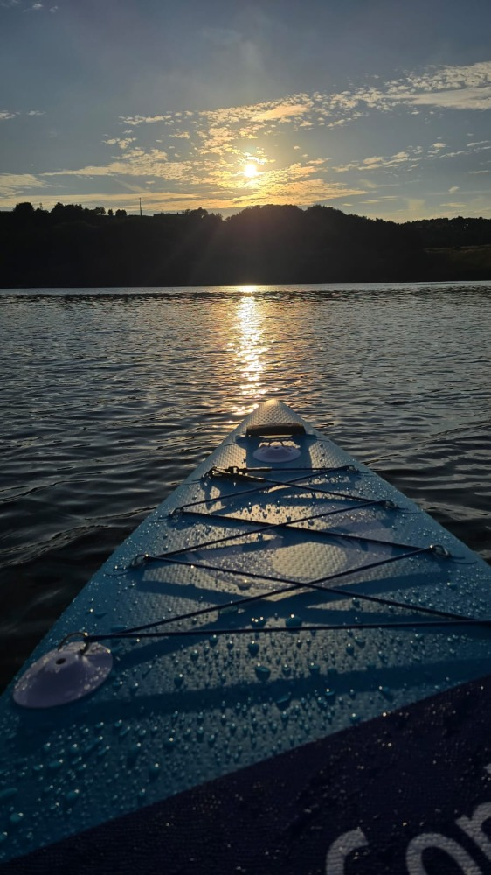
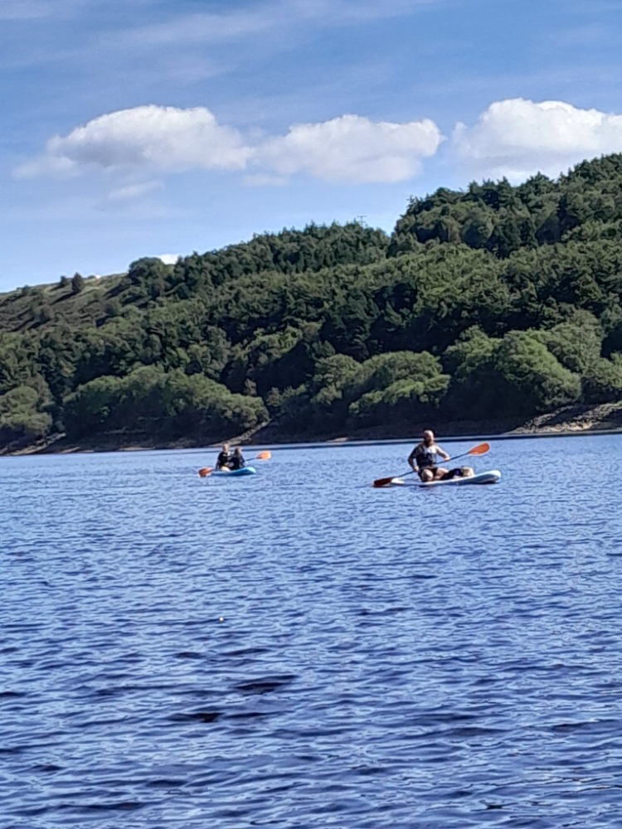
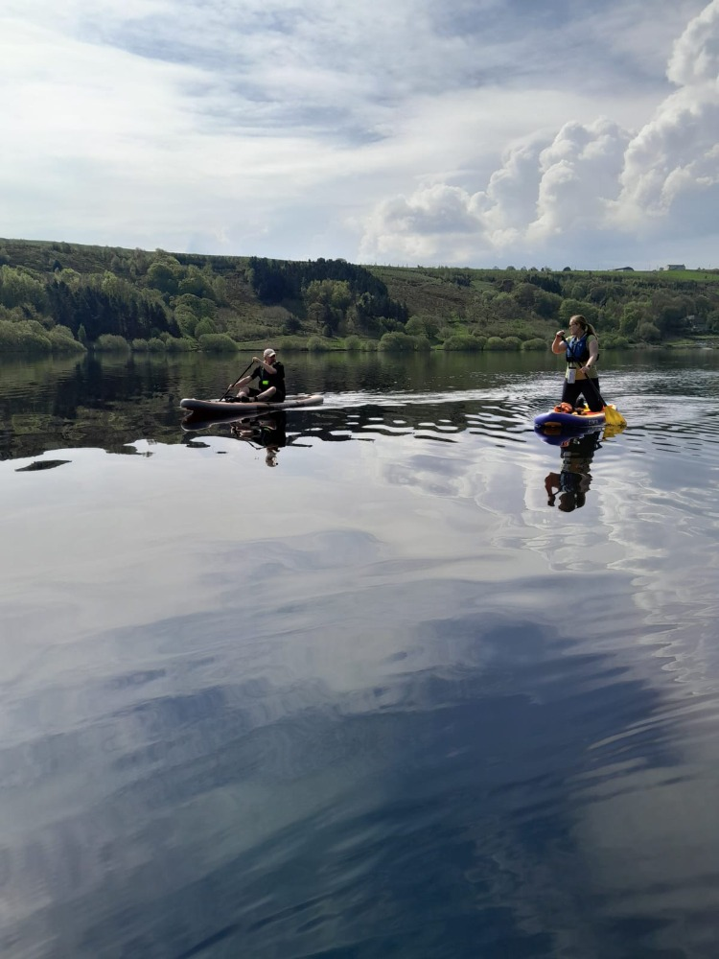
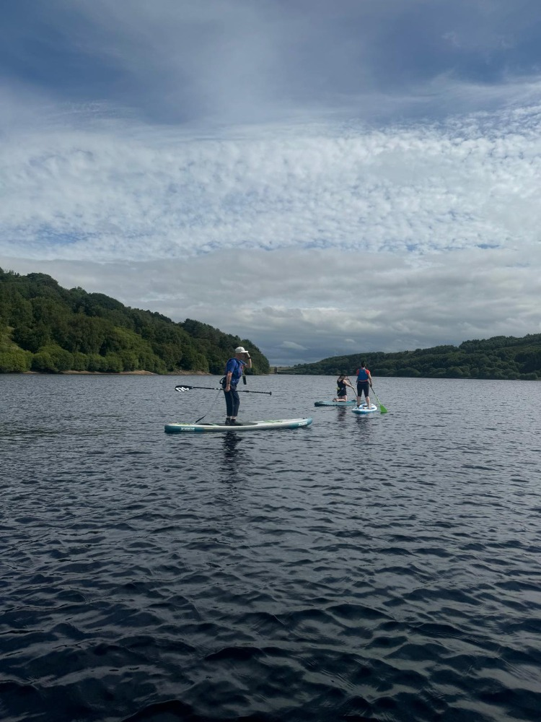
Photos courtesy of members

Slide 51


